Slide 1
Reading Group
Efficient Encoding Schedules for XOR-Based
Erasure Codes
2014
Presenter: Tianyang Niu

Slide 2
Outline
1
Background
2
Motivation
3
Design
4
Evaluation
3
5
Conclusion

Slide 3
Outline
1
Background
2
Motivation
3
Design
4
Evaluation
3
5
Conclusion

Slide 4
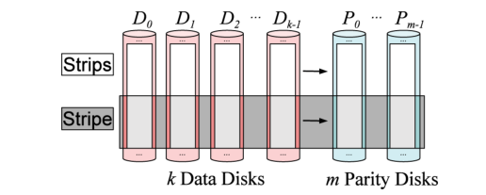
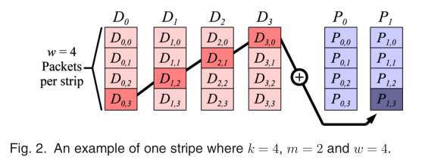
Background

Slide 5
Outline
1
Background
2
Motivation
3
Design
4
Evaluation
3
5
Conclusion

Slide 6
Motivation
EVENODD
p data columns and 2 parity columns and row p-1
p(p-1）packets
Operations 2p²-2p-1
Two solution
0%
（2p²-2p）*3
100%
（p-1）*（p+2）

Slide 7


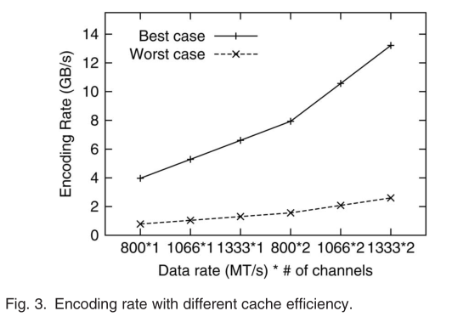
Motivation

Slide 8
Outline
1
Background
2
Motivation
3
Design
4
Evaluation
3
5
Conclusion

Slide 9
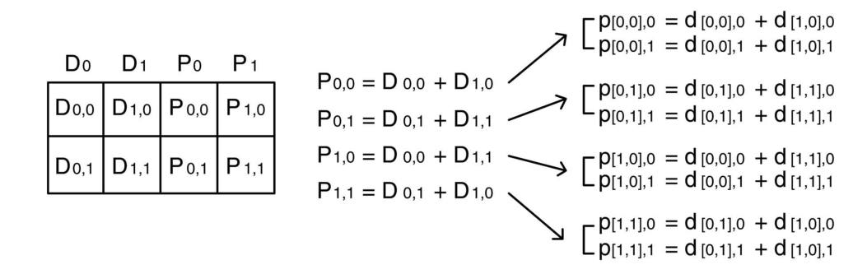
Design
XOR-SCHEDULINGALGORITHMS
K=2,m=2,w=2, packet size = 2

Slide 10
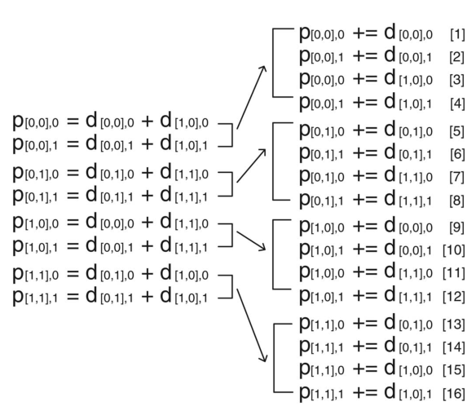
Design
PPG

Slide 11
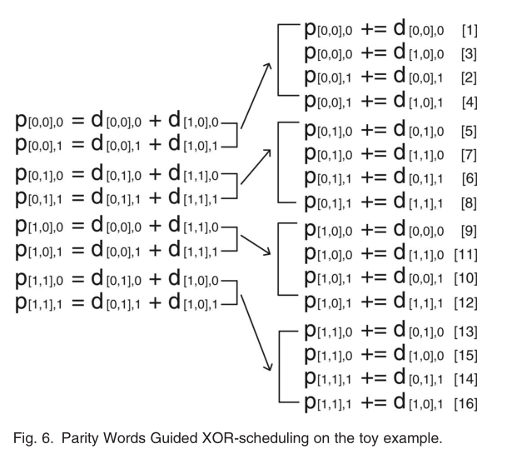
Design
PWG

Slide 12
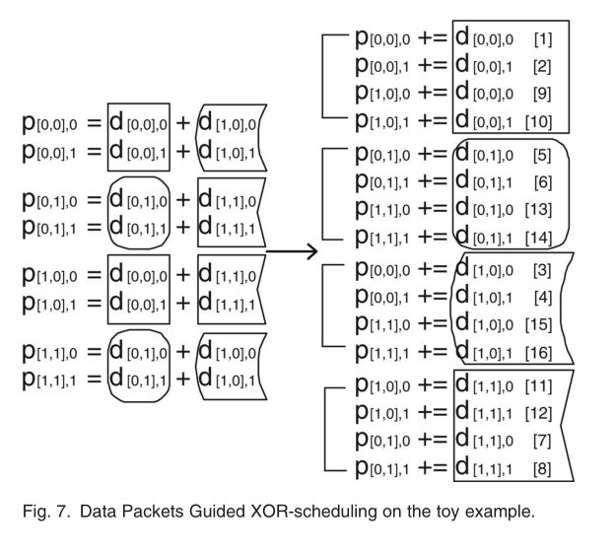
Design
DPG

Slide 13
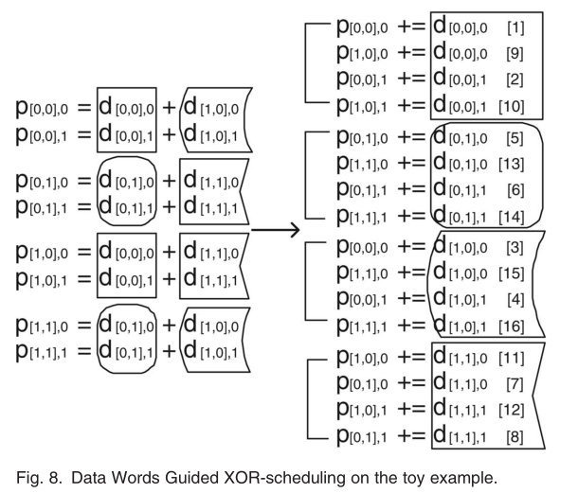
Design
DWG

Slide 14
Outline
1
Background
2
Motivation
3
Design & Implementation
4
Evaluation
3
5
Conclusion

Slide 15
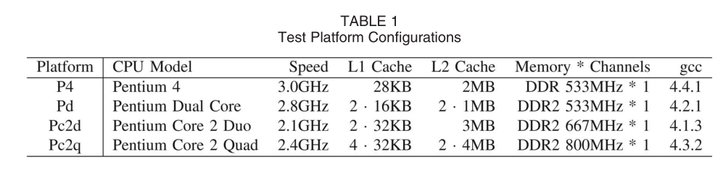

Evaluation
Liberation codes

Slide 16
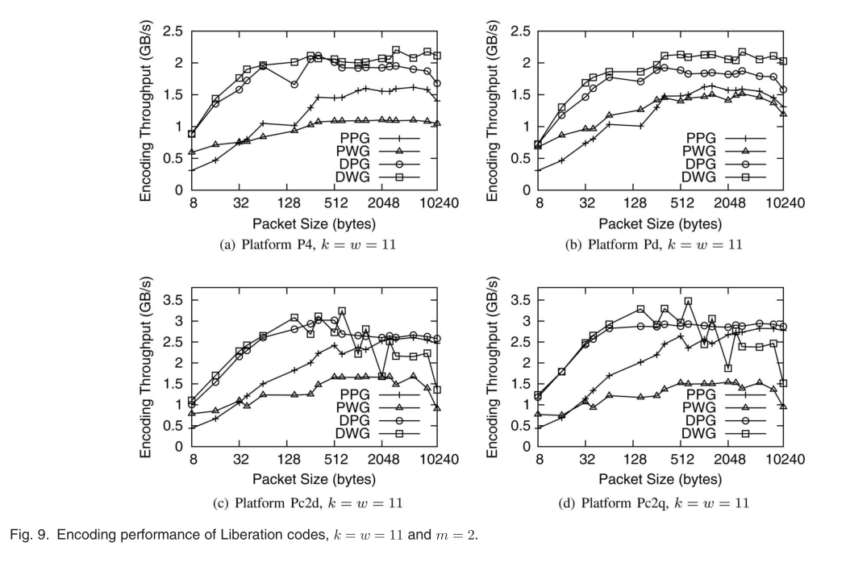
Evaluation

Slide 17
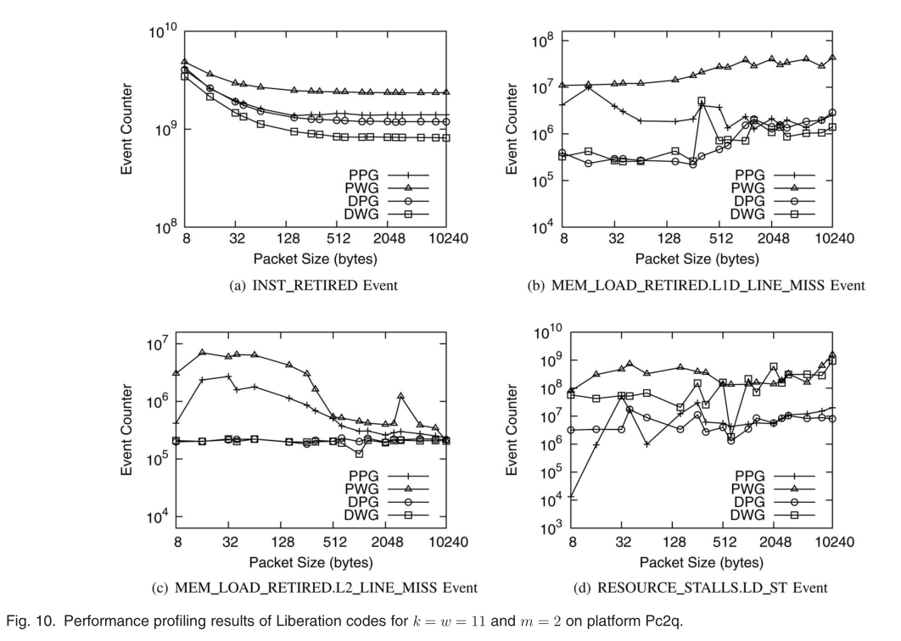
Evaluation

Slide 18
Outline
1
Background
2
Motivation
3
Design
4
Evaluation
3
5
Conclusion

Slide 19
Conclution
DWG DPG
In general, as the amount of data is accessed much more than that of parity in the encoding process, preserving data locality is more critical for high performance.

Slide 20
THANK YOU

